Slide 1
Fertility Preservation In Young Cancer Survivors
SIG Endocrinology 2019
Chairperson – Madhuri Patil

Slide 2
Radiotherapy and Chemotherapy are Gonadotoxic
Male
Oligospermia
Azoospermia
Female
Irregular menstrual cycle
POF
Infertility
After Treatment
Depending on:
Age
Medication
Dose

Slide 3
Fertility preservation and method used depends on
Though the initial treatment plan is known, final treatment course is not known
Pregnancy recommended only 2 years after chemo TX
Age
Type and dose of adjuvant therapy
Time available before chemotherapy and/or radiotherapy
Length of delay to childbearing post chemotherapy and/or radiotherapy

Slide 4
Effect of Radiotherapy and Chemotherapy on Male Fertility
Chemo and Radiotherapy
Damage to SSCs resulting in permanent azoospermia
Damage to differentiating germ cells results in transient azoospermia
Damage to Sertoli cells
Loss of SSCs – Permanent azoospermia
Loss of differentiating germ cells - Transient azoospermia
Damage to Leydig cells (high doses) results in testosterone deficiency
Increased risk of aneuploidy, DNA damage and gene mutations if banking after starting chemotherapy

Slide 5
Fertility Preservation Options in Males
Intervention | Definition | Comment | Considerations
Sperm cryopreservation (S) after masturbation | Freezing sperm obtained through masturbation | Most established technique Large cohort studies in men with cancer | ●Outpatient procedure ● Approximately Rs.15,000 for three samples stored for 3 years, storage fee for additional years!
Sperm cryopreservation (S) after alternative methods of sperm collection | Freezing sperm obtained through testicular aspiration or extraction, electro-ejaculation, or from a post-masturbation urine sample | Small case series and case reports | Testicular sperm extraction-outpatient surgical procedure
Gonadal shielding during radiation therapy (S) | To reduce the dose of radiation delivered to the testicles | Case series | ● Only possible with selected radiation fields and anatomy ● Expertise is required to ensure shielding does not increase dose delivered to the reproductive organs
Testicular tissue cryopreservation Testis xenografting Spermatogonial isolation (I) | Freezing testicular tissue or germ cells and re-implantation after cancer treatment or maturation | Has not been tested in humans; successful application in animal models | Outpatient surgical procedure
Testicular suppression with gonadotropin releasing hormone (GnRH) analogs or antagonists (I) | Use of hormonal therapies to protect testicular tissue during chemotherapy or radiation therapy | Studies do not support the effectiveness of this approach

Slide 6
Options for fertility preservation in female patients tailored according to
Patient’s age
Type of disease
Spread of the disease
Planned treatment
Time available
Whether has a partner or not?
Injury to
Hypothalamus and Pituitary
Ovaries
Uterus

Slide 7
Effect of Radiotherapy and Chemotherapy on female Fertility
Effective sterilising doses for radiotherapy are
20·3 Gy at birth
18·4 Gy at 10 years
16·5 Gy at 20 years
14·3 Gy at 30 years
Disrupt uterine anatomy
Diminish muscular elasticity
Increase fibrosis
Vascular damage
Cervical incompetence
Chemotherapy results in direct and indirect damage to ovaries by
Apoptosis
Vascular Injury
Cortical Fibrosis
Resulting in destruction of growing follicles and loss of primordial follicles and corresponds to the dose, duration and type of chemotherapeutic agent used (More with Alkylatying agent)

Slide 8
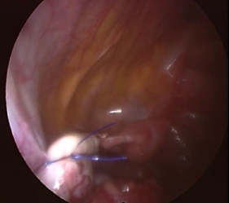
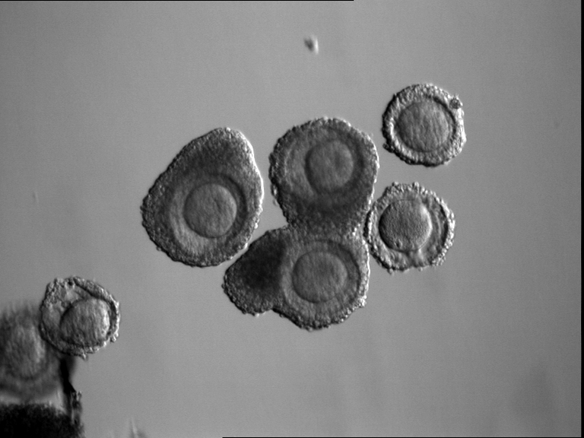
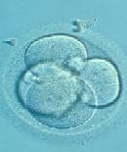
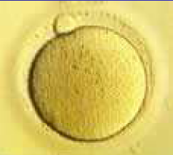
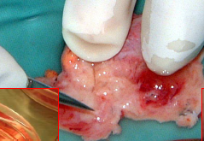
Fertility Preservation for Female Cancer Patients
Fertility Sparing surgery in early stages of Ca Cervix, endometrium and ovary
Ovariopexy during pelvic irradiation
Oophorectomy or ovarian cortex isolation
Chemotherapy cannot be delayed/hormonal stimulation CI
Chemotherapy can be delayed/hormonal stimulation not CI
GnRha before & with chemotherapy
Immature oocyte retrieval
Ovarian Stimulation
TAM/Letrazole
TAM + FSH/Let +FSH
Immature oocyte retrieval from ovarian tissue
IVM
Male partner available (ICSI)
Male partner not available
Male partner available (ICSI)
Male partner not available
Ovarian tissue cryopreservation
Heterotopic transplantation
Embryo cryopreservation
Oocyte Vitrification
Embryo cryopreservation
Oocyte Vitrification
Orthotopic transplantation

Slide 9
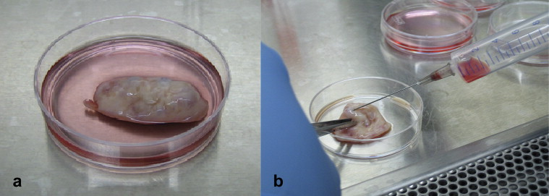
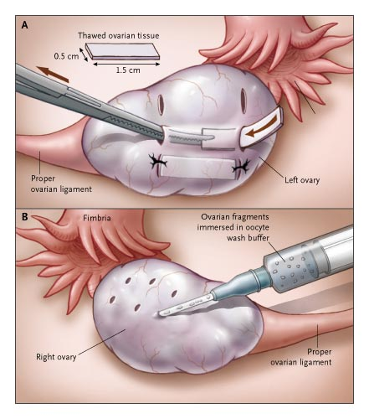
Fertility Preservation strategies in Female Cancer patients depending on risk of Ovarian involvement
Low risk of ovarian involvement
High risk of ovarian involvement
Ovarian Transposition before radiotherapy
Chemotherapy can be delayed 4 -6 weeks
Chemotherapy cannot be delayed
Ovarian tissue cryopreservation
Ovarian Cryopreservation
Embryo/oocyte Cryopreservation
IVM
Xenografting
Estrogen Sensitive
Estrogen Insensitive
Ovarian Cryopreservation
OI with Tamoxifen/ Letrazole
Conventional ovarian stimulation
Heterograft
Autograft
HRU 10-3:251-256;2004

Slide 11
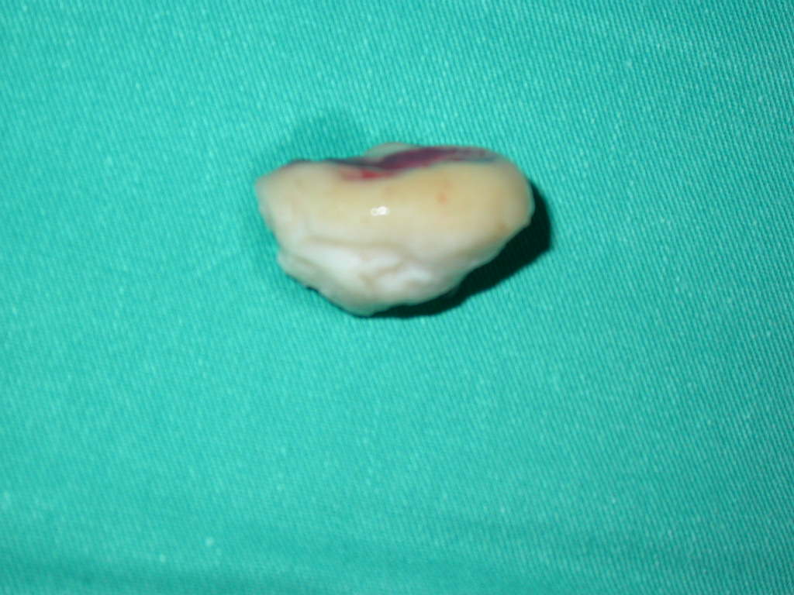
Fertility Sparing Surgery In
Early-stage Cervical Cancer
ID<3 mm
LVSI(-)
Stage IA1, IA2
Conization < 10 mm
Does not affect fertility potential
Increase risk of
PTD
PROM
Operative delivery
Conization
Margin (-)
Follow-up

Slide 12
Fertility Sparing Surgery
in Early-Stage Cervical Cancer
Stage IA1 (LVS +)
Stage IA2 (LVS ±)
Stage IB-IIA (≤2cm)
Intra surgery
Ovarian tissue cryopreservation possible
Five year survival rate – 96.8%
ART is safe for lesions < 2cm
Post Surgery – IVM or IVF
Desire of fertility
Lymph Node Dissection
(L/S, L/T)
Node (-)
Node (+)
Sentinel Lymph Node
RT
Radical Trachelectomy

Slide 13
Fertility Preservation in Endometrial Carcinoma
Candidate for P4
Stage 1 Grade 1-2
Not a candidate for P4
Surgery can be delayed for 2 -6 wks
Surgery cannot be delayed
P4 for 3 months followed by D & C with or without hysteroscopy
Persistence of atypical cells
Surgical staging + hysterectomy
NED
IVF –
AI + FSH
OI
Ovaries preserved
BSO
Attempt Pregnancy
Oocyte cryopreservation
Embryo cryopreservation
Ovarian tissue cryopreservation
Gestational Carrier
Fertil Steril 2007

Slide 14
Fertility Preservation in Ovarian Cancer
Borderline Ovarian tumors
Conservative surgery in stage 1A
Intra surgery oocyte and ovarian tissue cryopreservation
Epithelial Ovarian tumors
Stage IA, 1C grade 1 and grade 2 tumors of mucinous, endometrioid or serous types suitable for fertility sparing surgery
Oophorectomy with cryopreservation of ovarian tissue from contralateral ovary and IVM from aspirated follicles
Germ Cell tumors
Sensitive to chemotherapy
Majority will resume normal menstrual function following chemotherapy
Post surgery COS with IVM or IVF
Oophorectomy with preservation of contralateral ovary followed by IVM or IVF
If oophorectomy required cryopreservation of ovarian tissue and IVM from aspirated follicles of the contralateral ovary
Must monitor contralateral ovary by USG and tumor markers regularly
Once fertility complete oophorectomy

Slide 15
Preserving fertility before Cancer Treatment
Cancer Treatment and Fertility Risk
some cancer treatments can cause infertility (inability to have a child) or decrease your fertility (ability to have a child).
• Your age and sex
• Whether you had fertility problems before treatment
• the type of cancer you have and the treatments you receive
When Diagnosed
consider your fertility risks, even if you aren’t sure you want to have children
A reproductive specialist is a doctor who specializes in fertility problems and can help explain your options for preserving fertility
Your Options
Reproductive specialist provides information on the procedures that work well for preserving fertility, those still being researched, and those that don’t work well
Fertility preservation methods can take as little as 24 hours for men, and methods for women now take less time than the
2 to 4 weeks needed in the past
Your risk depends on
Ask for a referral to a reproductive specialist
Timing is important

Slide 16
Women
Recommended
Embryo cryopreservation
Oocyte cryopreservation
Surgery and radiation therapy given in specific ways to
avoid harming a woman’s reproductive organs
Investigational
Ovarian tissue cryopreservation
Ovarian suppression
Men
Recommended
Sperm cryopreservation or sperm banking
investigational
Testicular tissue cryopreservation and reimplantation
Children and Teen
Recommended
For children who have been through puberty:
Semen cryopreservation,for boys Oocytecryopreservation for girls
Investigational
For children who have not been through puberty:
Testicular tissue cryopreservation
for boys
Ovarian tissue cryopreservation for girls
Not recommended
Hormonal therapy

Slide 17
Summary
Assessment of risk for infertility
Communication with patient
Patient at risk for treatment induced infertility
Patient interested in fertility preservation options
Refer to specialist with expertise in fertility preservation methods
Eligible for fertility preservation
Female
Established
Embryo cryopreservation
Oocytes cryopreservation
Conservative gynecologic surgery
Oophoropexy
Male
Established
Sperm Cryopreservation
Investigational FP techniques
Cryopreservation of ovarian and testicular tissue
Ovarian suppression

